Slide 1
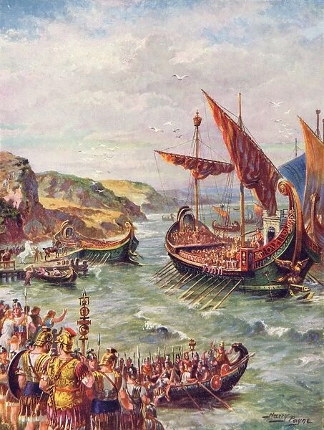
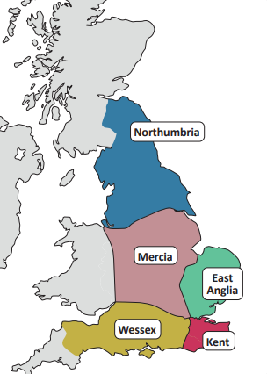
Year 3 – Spring Term History – Who were the Anglo Saxons?
Vocabulary and Glossary |  | When and why did the Romans leave England?
Christianity | A religion based on the teachings of Jesus Christ
Conquer | Overcome and take control of a place or group of people
Invasion | When a foreign army enters a country by force
Monastery | A building where monks live, work, study and pray, separate from the outside world
Monk | A member of a male religious community who lives in a monastery
Pagan | A person who believes in many gods or does not follow one of the world’s major religions | Why did the Anglo Saxons invade England and where did they settle?
Reeve | A local official in Anglo-Saxon England
Wattle and daub | A traditional building material made from woven twigs or sticks and mud.
Kingdom | An area ruled by a king
Pict | A person living in northern Scotland during the Roman occupation of Britain
Celt | A person of European origin who lived in Britain before the Roman invasion
The Romans left England in AD410 because Rome was under attack and the empire was falling apart. They left behind new towns, roads, plants, animals, religion, language and more. Many towns fell into disrepair and the country became vulnerable to attack from the Picts and Scots in the north.
The Picts and Scots tried to invade after AD 410 because Britain was undefended. In AD 449, an English leader, Vortigern, asked the Jutes to come to England to help. However, the Jutes realised that the land was good for farming so along with the Angles and the Saxons, they invaded England.
They invaded the east and south coasts and pushed the Celts back west. They split England into 7 kingdoms. The rulers of the kingdoms fought each other for land and power. By AD 800, there were 5 main kingdoms – East Anglia, Kent, Mercia, Northumbria and Wessex. The Celts lived in Wales, Cornwall, Scotland and Ireland.
.

Slide 2
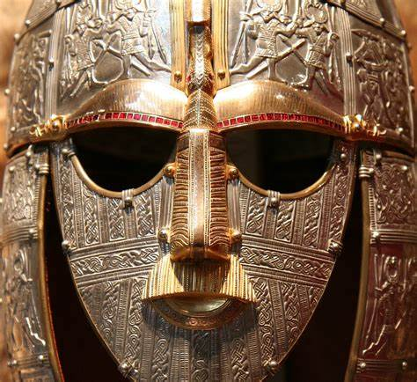
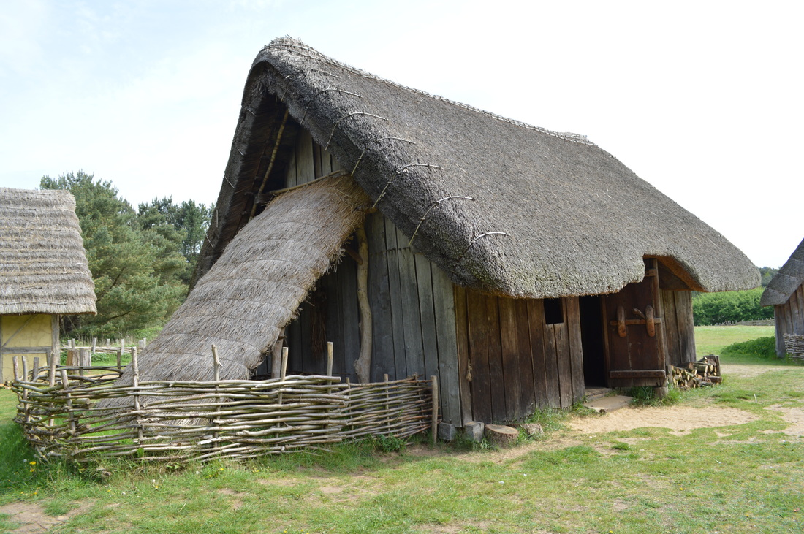
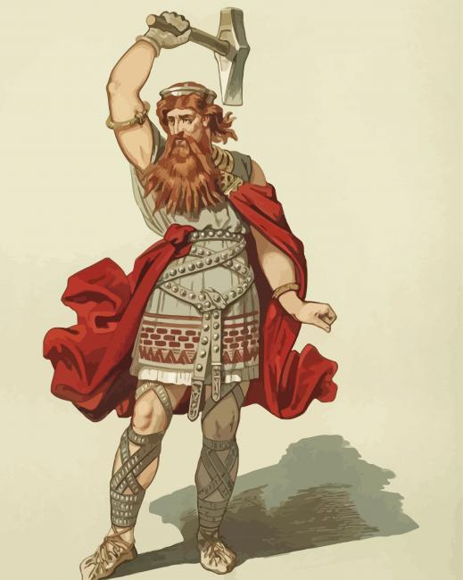
Who were the Anglo Saxons?
What was everyday life like in Anglo Saxon times? | How do we know about the Anglo Saxons?
What did the Anglo Saxons believe in? | What impact have the Anglo Saxons had on life today?
Anglo-Saxon society had a hierarchy, with a king at the top. Landowners, called thegns, were below the king and peasant farmers worked on the thegn’s land. Slaves were at the bottom of the hierarchy. Most Anglo-Saxons were farmers or craftspeople. They lived in homes made from wood or wattle and daub, with a single room and central fireplace. Settlements were surrounded by high fences to protect animals and villages from thieves and attack.
Much of what we know about the Anglo Saxons comes from graves, like the one discovered at Sutton Hoo in Suffolk. At Sutton Hoo there are 11 mounds or ‘barrows’ dating back to the 7th century. In 1939 archaeologists explored the largest mound and found a ship buried there. The artefacts discovered there tell us a lot about Anglo Saxon life.
In Roman Britain many people had been Christians. But the early Anglo-Saxons were not Christians – they were pagans. The Anglo-Saxons had their own gods, beliefs and superstitions. Anglo-Saxons believed in lucky charms. They thought that rhymes, potions, stones and jewels would protect them from evil spirits or sickness. Over time their beliefs changed and many Anglo-Saxons were converted to Christianity by monks. They also established churches and monasteries.
There are still aspects of life in modern England that date back to the Anglo Saxons, including the English language, the rule of law, place names, Christianity and even the layout of England itself.
Place Name | Meaning
- Burgh/bury | Fort
- Ton | Fam or village
- Ham | Village
- Ley | Clearing
- Wich | Farm or dwelling
- Ford | River crossing

