Slide 1
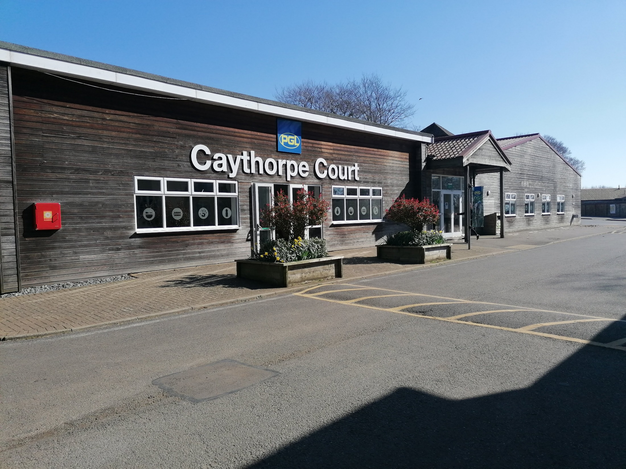
Year 6 at PGL 2025
Parent Information

Slide 2
Why are we going to PGL?
Part of our personal development offer
Confidence building
Prepare them for secondary by encountering new challenges
To have fun and create some final memories of their time at primary school!

Slide 4
Key information
When?
Please arrive between 15:00 and 15:30 on Sunday 8th June and pick up by 14:00 on 11th June.
Where?
Caythorpe Court, NG32 3ER. It’s the second turning on the right (not the deliveries entrance).
Who’s going?
Mrs McRobie and Mr Allen. Mrs Smith is hoping to join us for some of the time we are there.

Slide 5
Drop off and pick up…
Mr Allen will arrive early.
Unfortunately, parents will not be able to see the rooms and it would be best to leave relatively soon after arrival.
When picking up, please collect the children from where they were dropped in the car park area

Slide 7
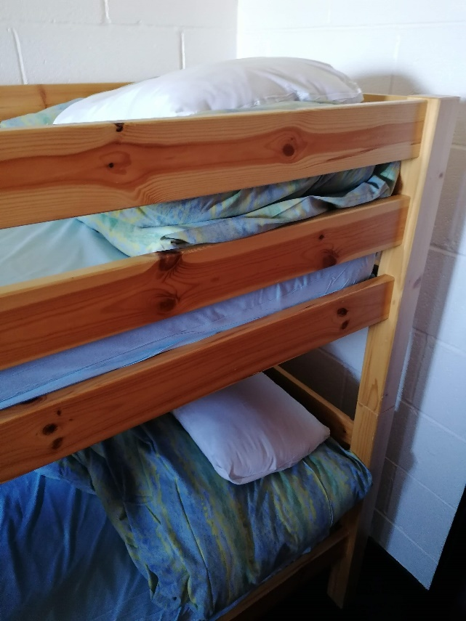
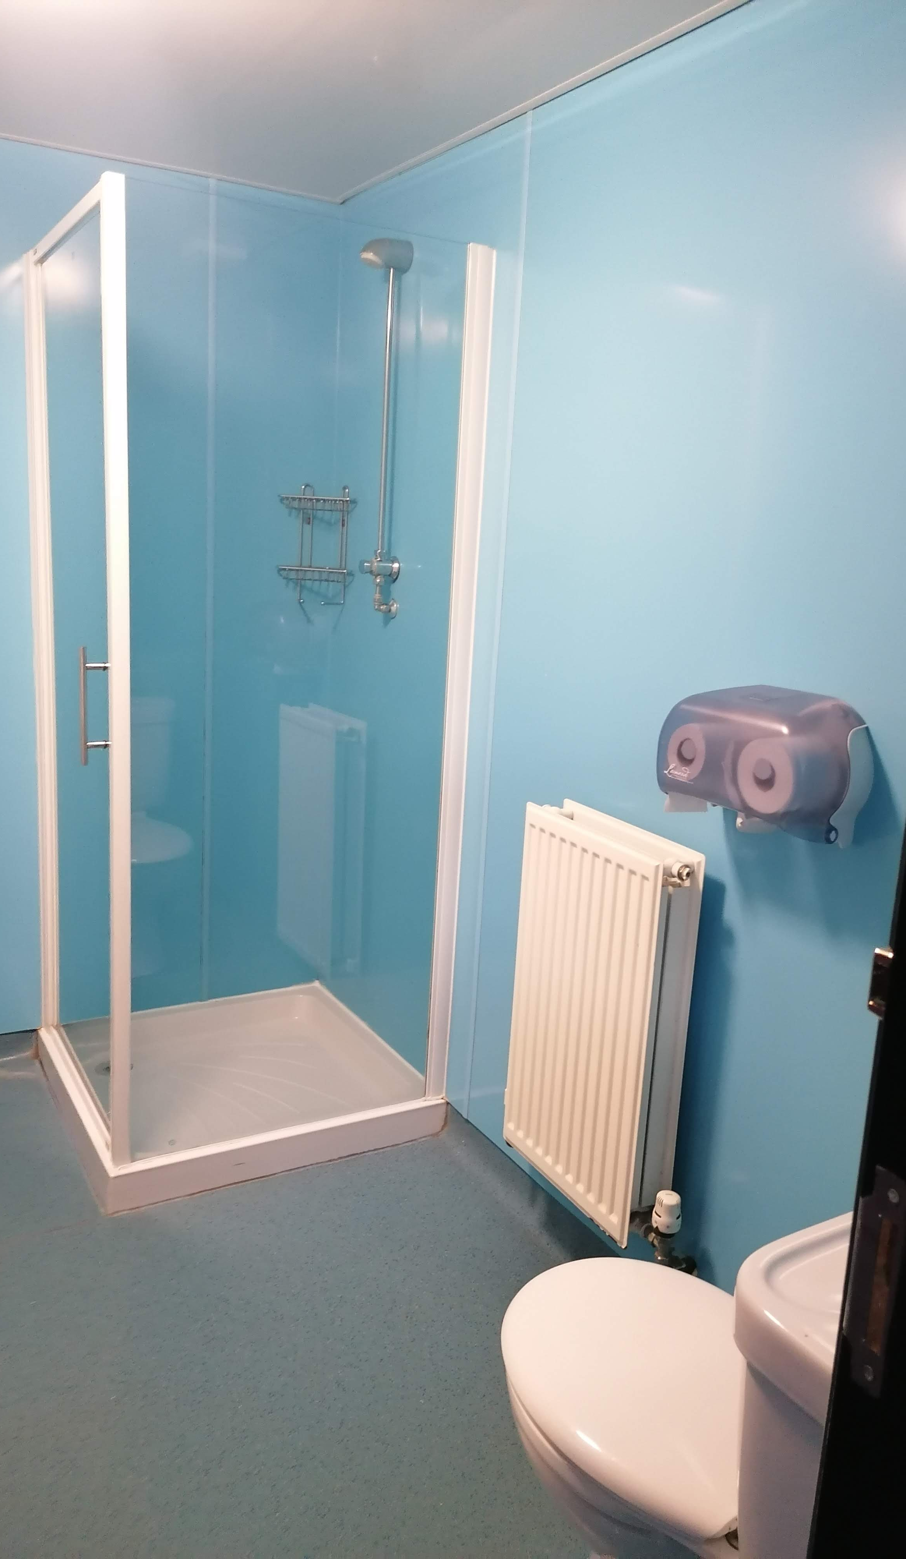
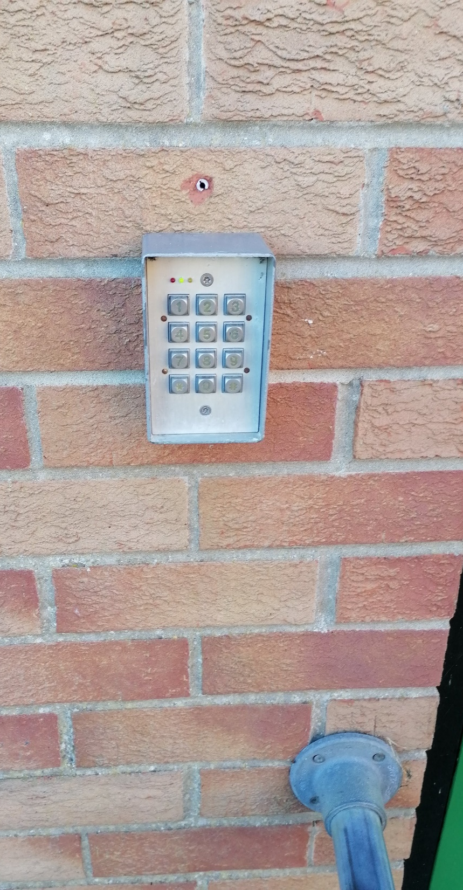
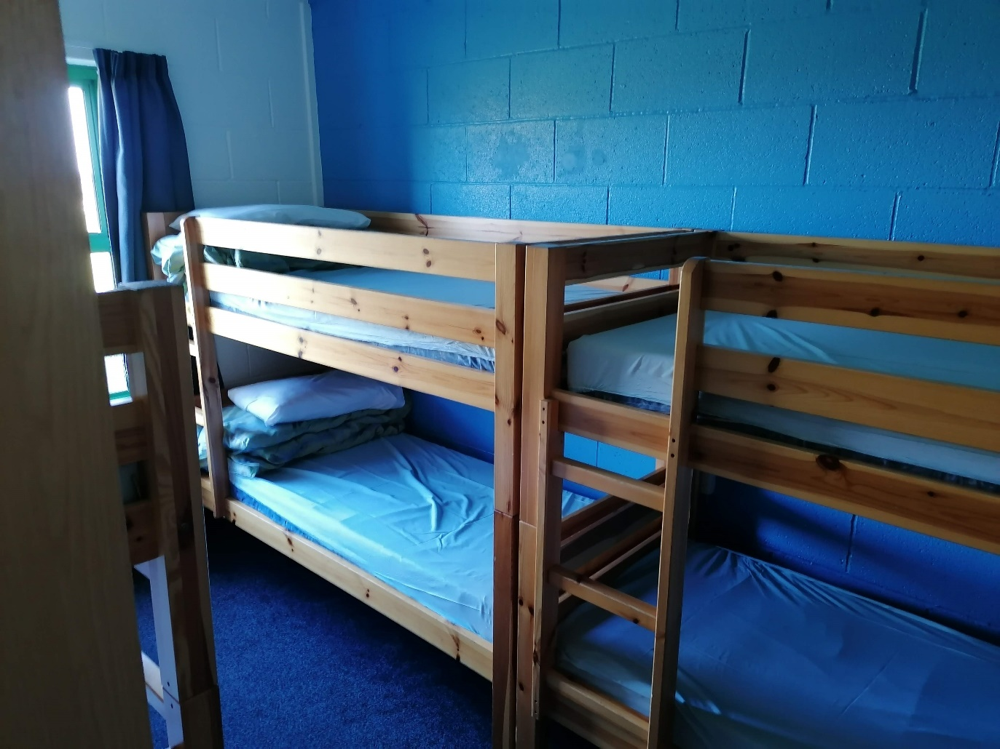

Slide 9
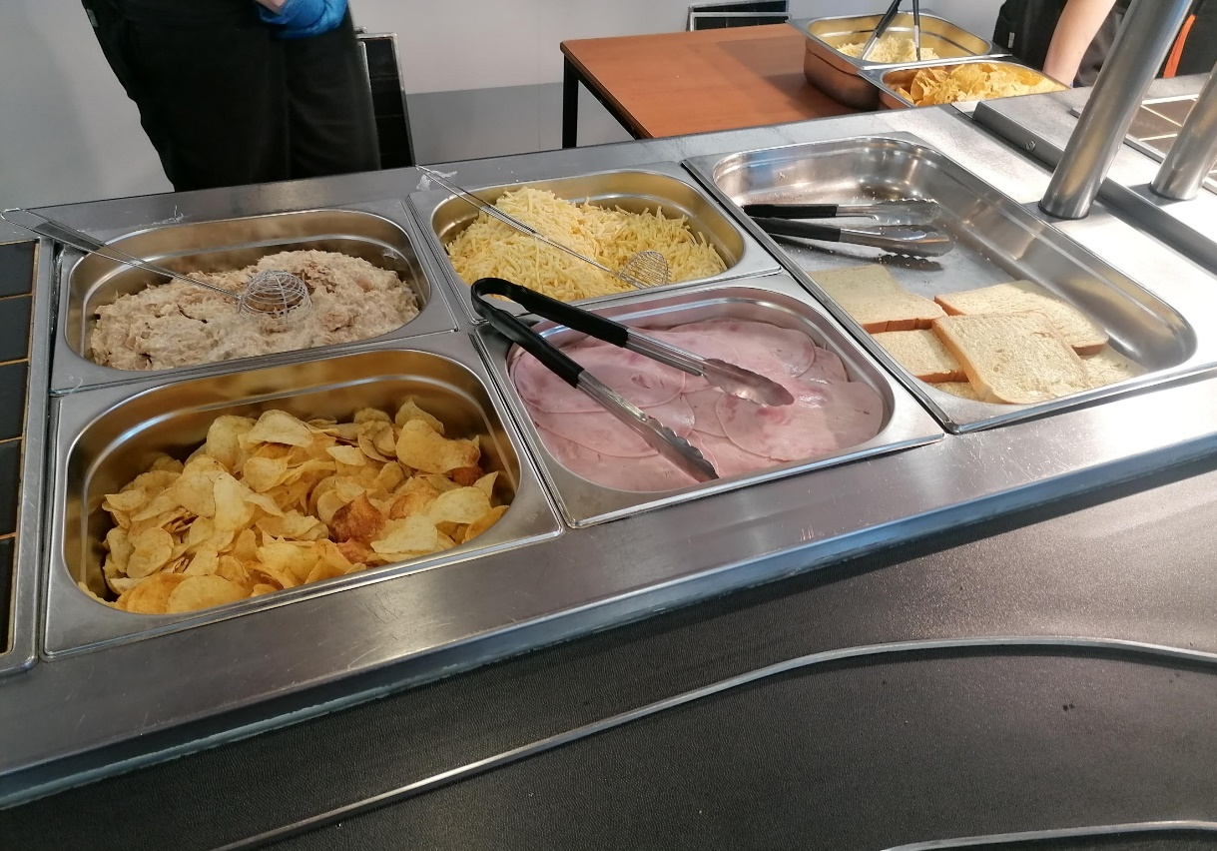
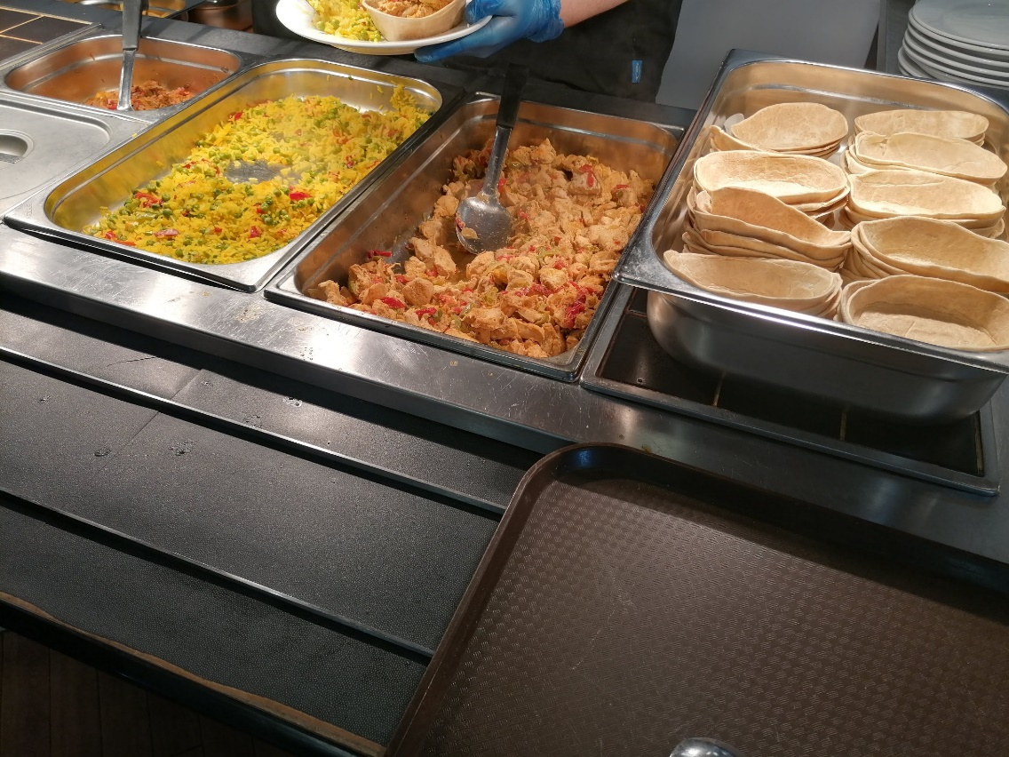
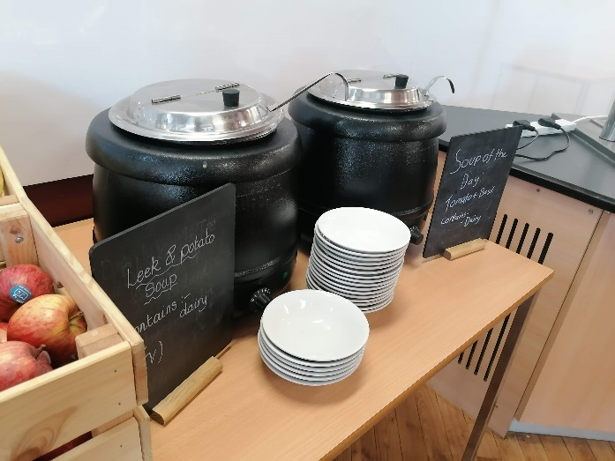
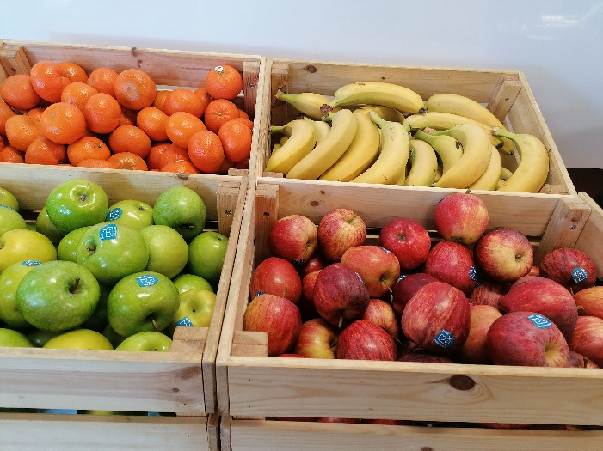
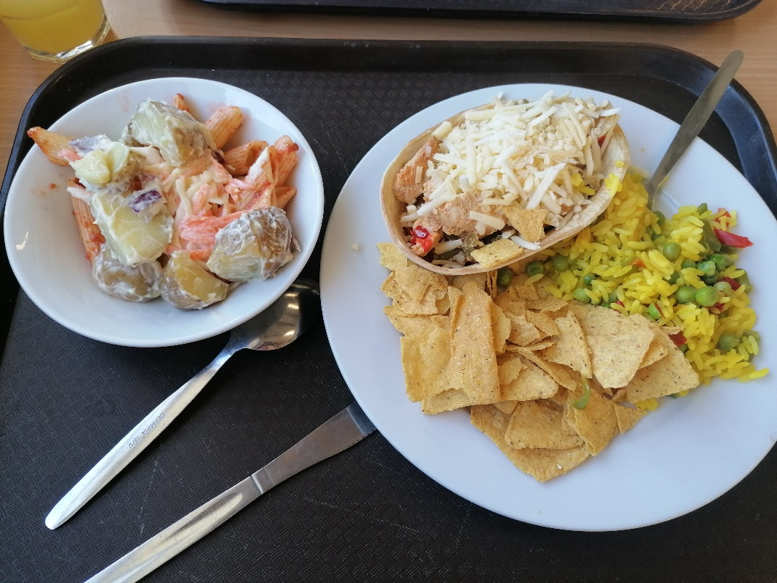
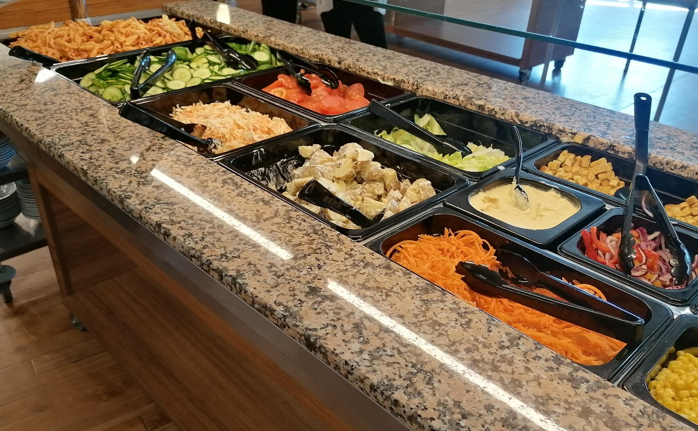

Slide 11
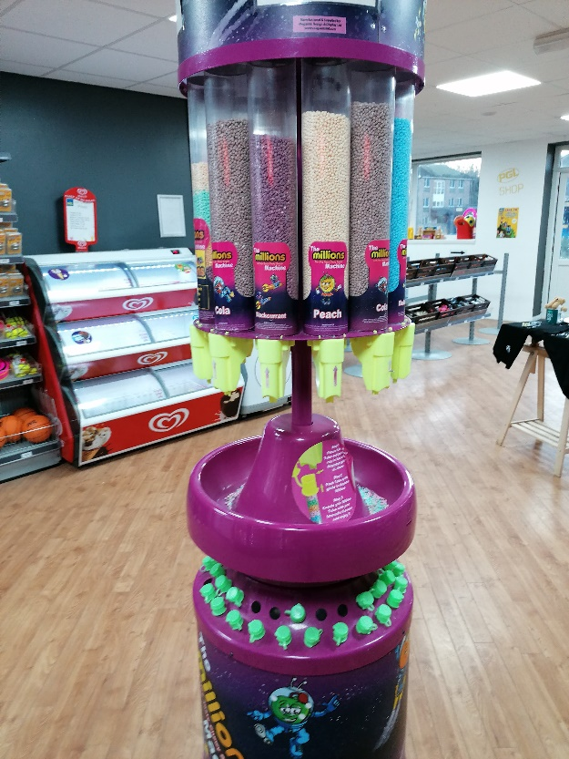
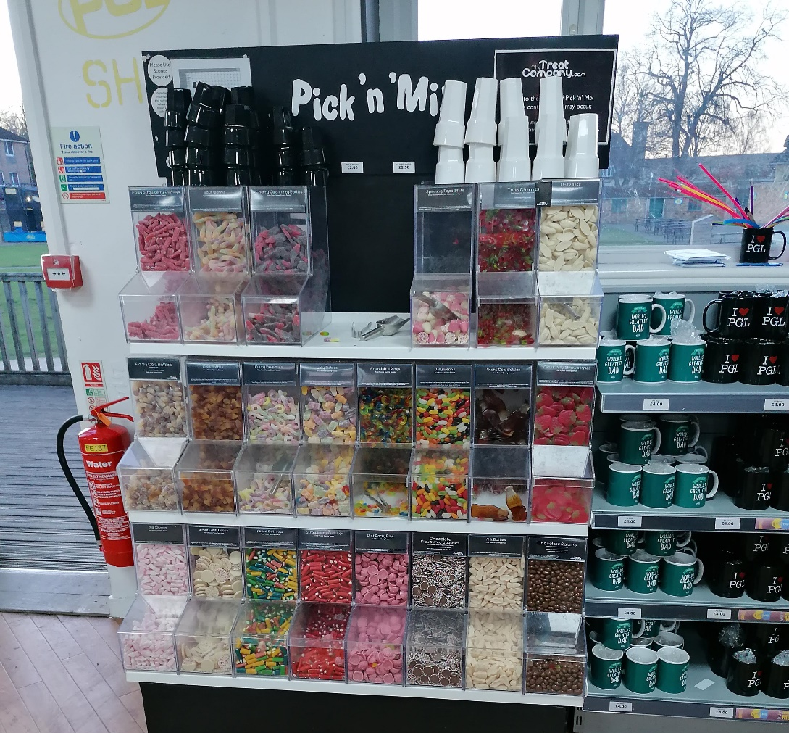
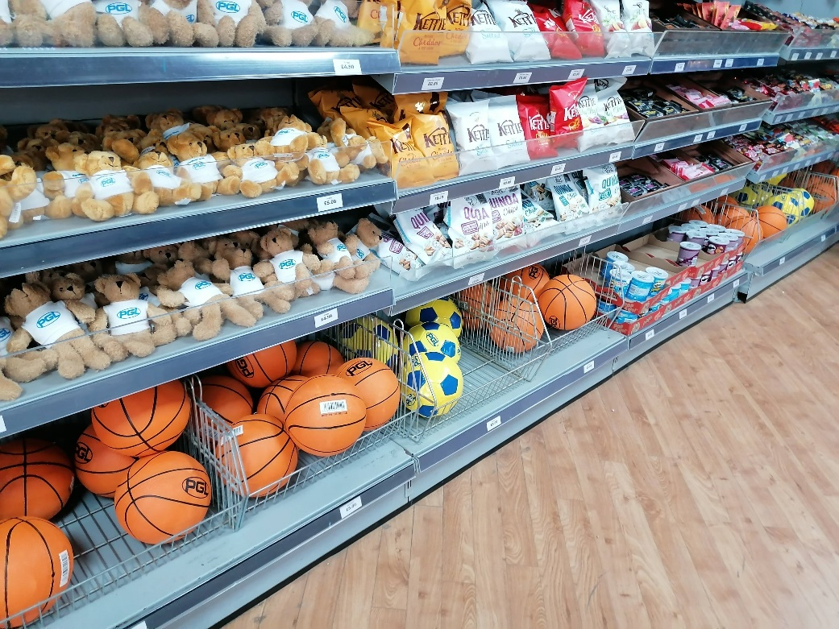
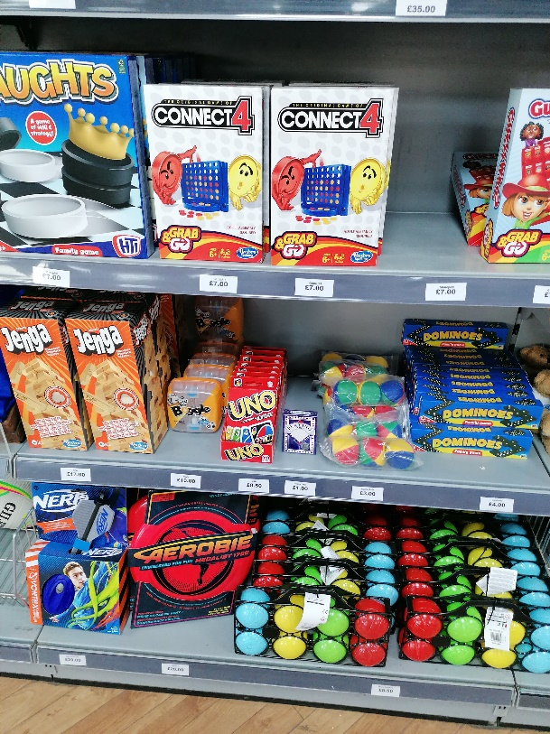
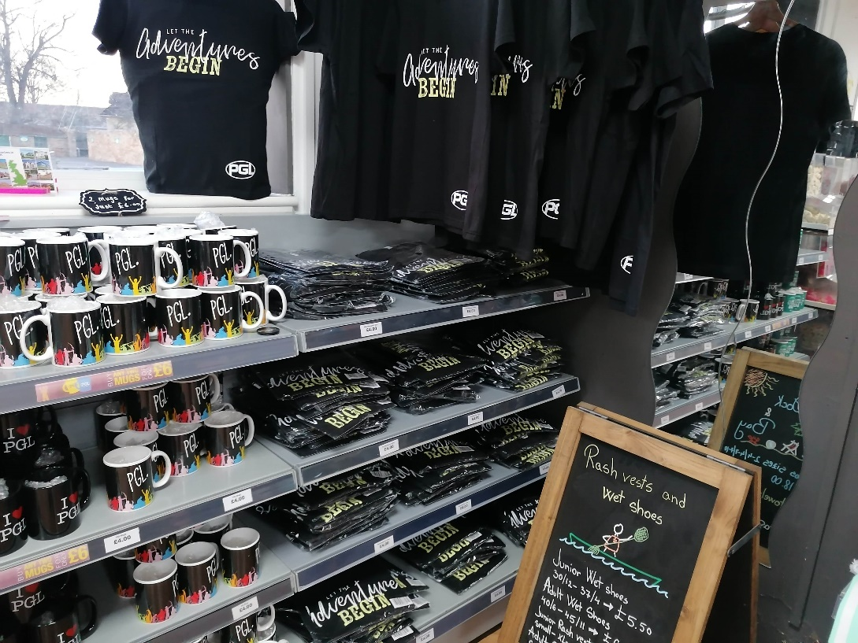
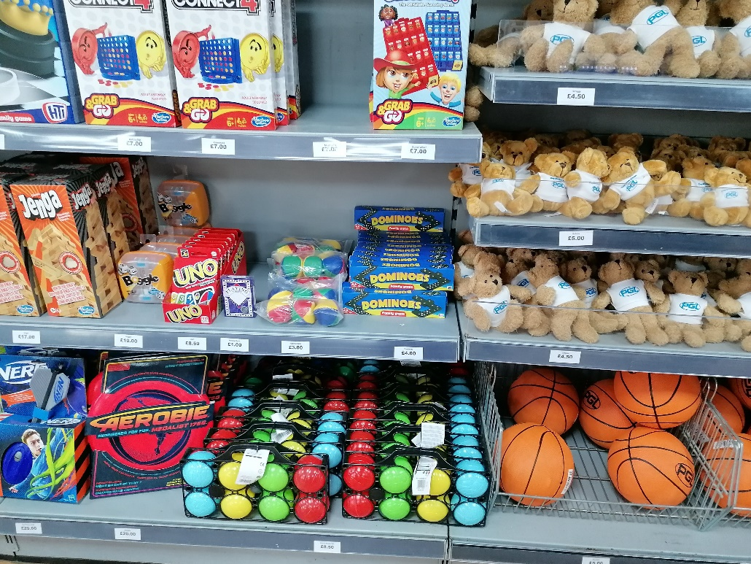

Slide 12
What will the children get up to?

Slide 13
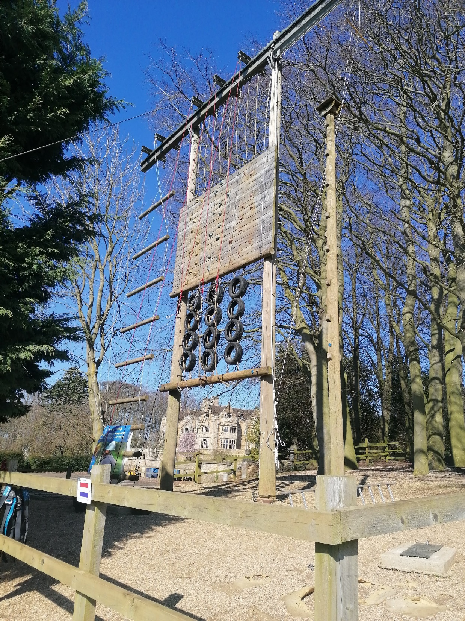

Slide 14
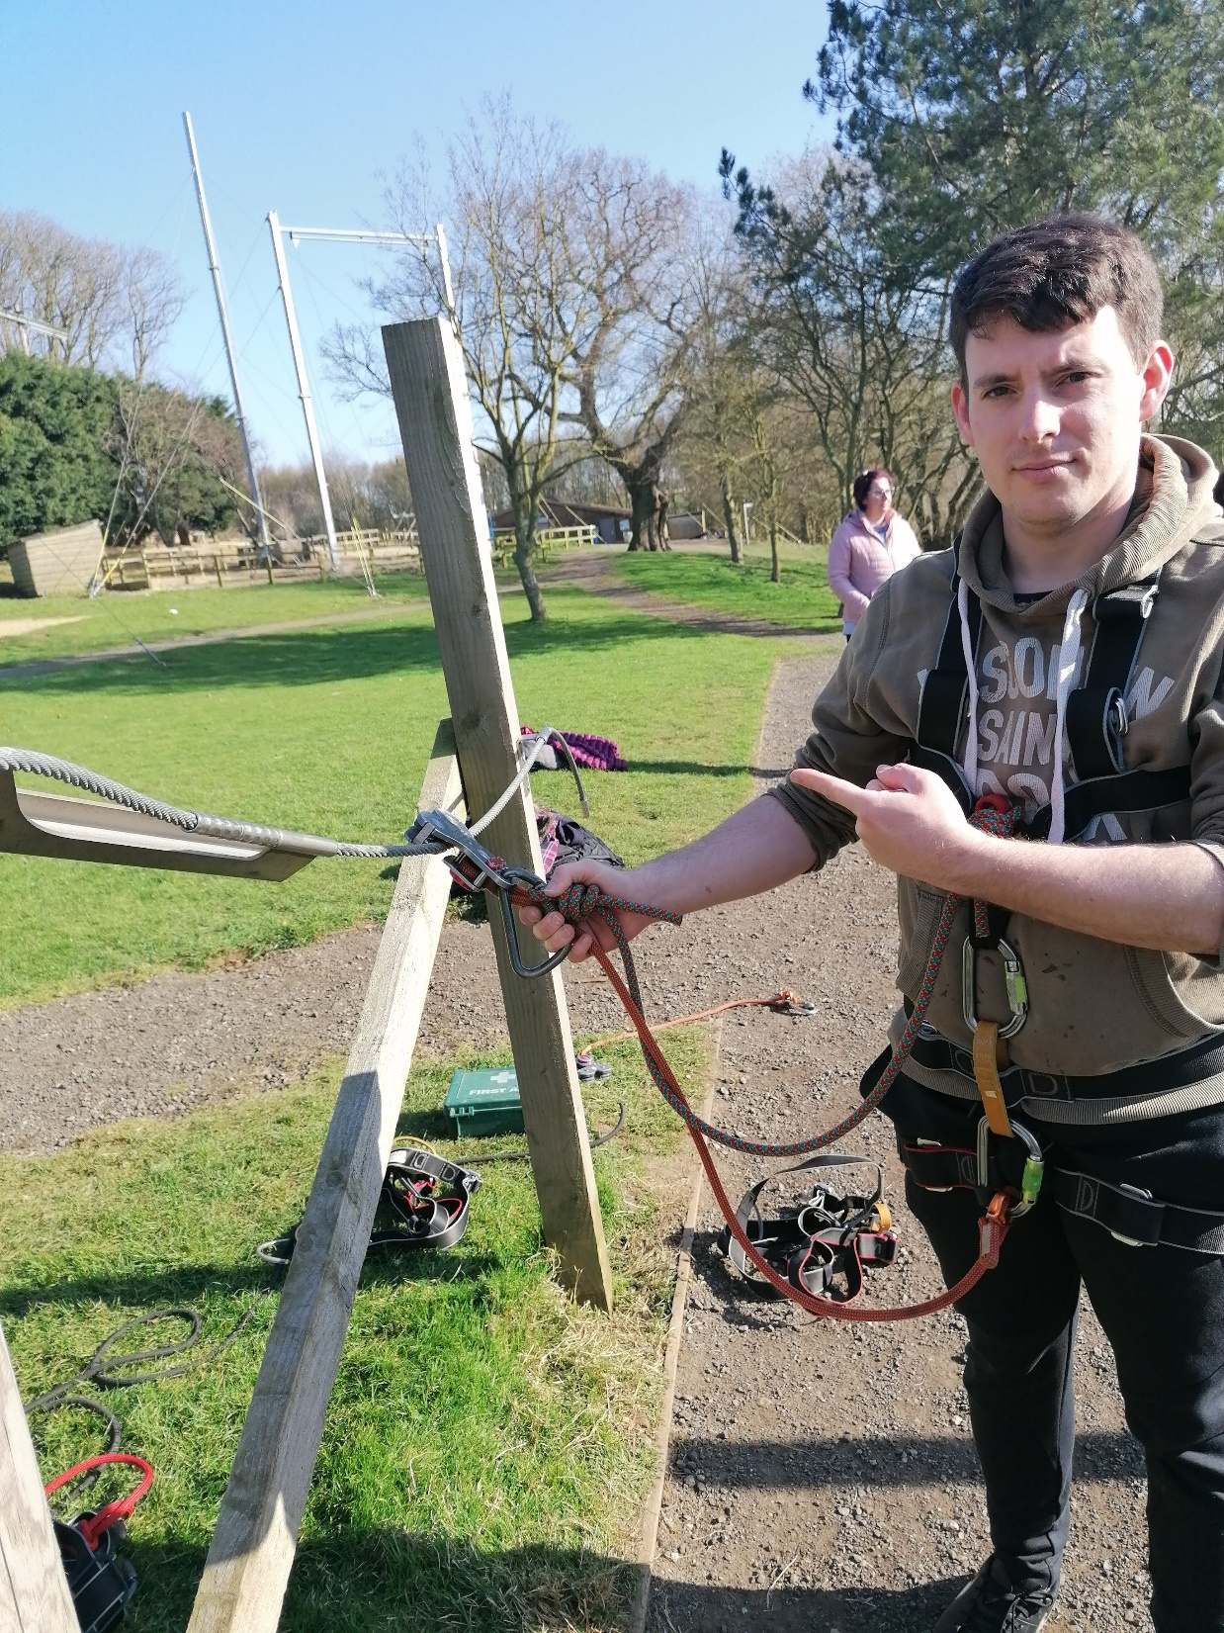

Slide 15
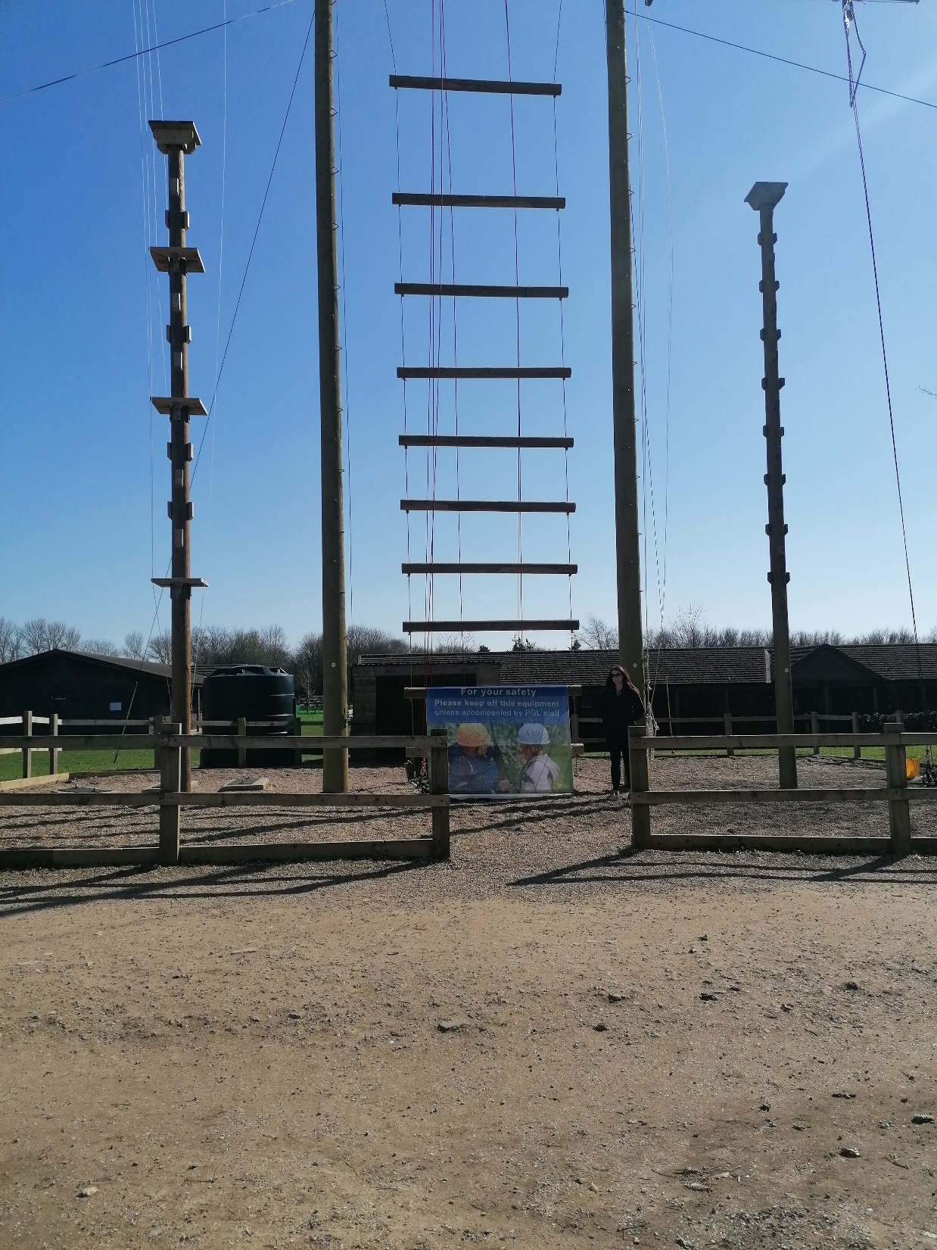

Slide 16
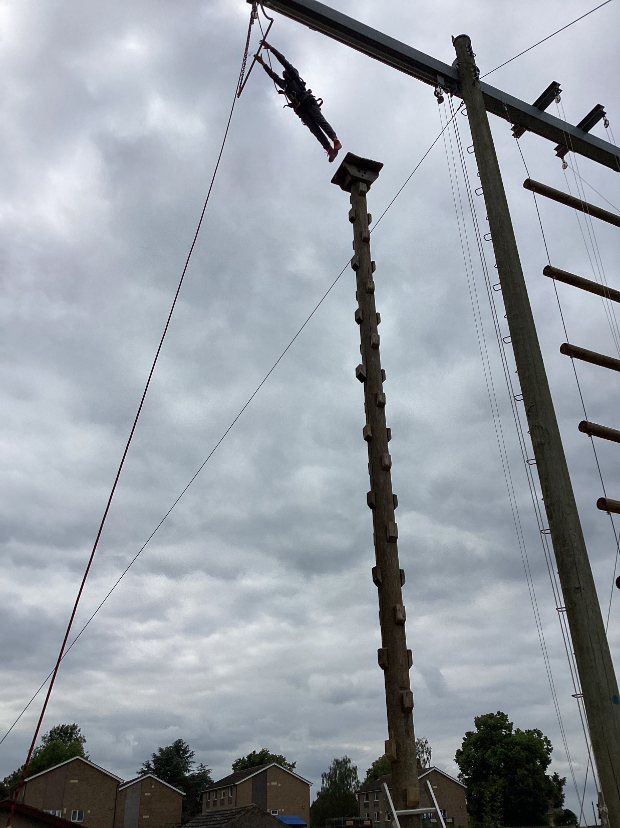

Slide 17
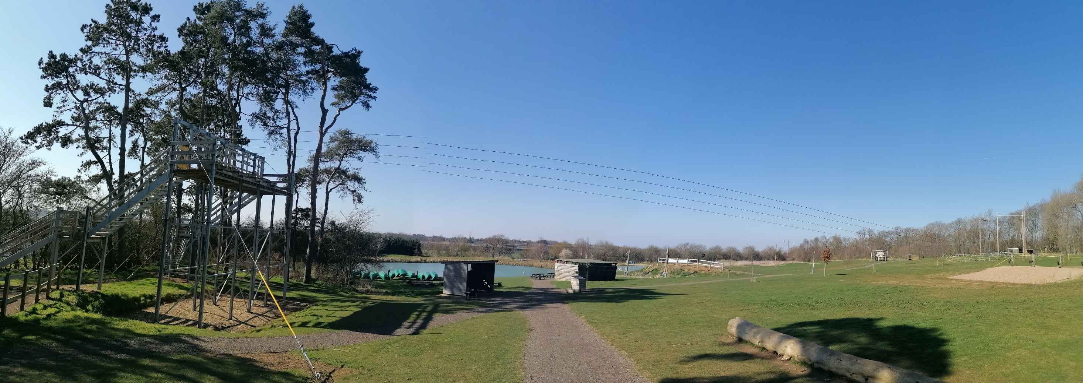

Slide 18
What to bring…
A sleeping bag/duvet with cover
Pillow
Washing kit
At least 2 towels – one you are happy to get muddy!
Sleeping gear – pyjamas, night dress etc
Changes of underwear and socks for 4 days – may need to change during the day
3 jumpers/fleeces
Multiple pairs of trousers/tracksuit bottoms for activities – no jeans; a pair for evenings

Slide 19
What to bring…
T-shirts
2 pairs of trainers (wet/dry activities)
Warm and waterproof jacket
Waterproof trousers if you have them – can be borrowed, please don’t buy!
Plastic bags for wet/dirty clothes
Plastic drinks bottle
Shorts
Sun hat/sun cream

Slide 20
Points to note:
Evenings can get cooler
Please label clothing
No mobile phones/electronic devices other than a camera
No smart watches
Deodorants – roll on rather than spray
Money - £10 maximum
Pack for every eventuality!
The last two years have been warm – a hot water bottle filled with cold water can be useful!
Parental Consent form

Slide 21
FAQs
Can children take phones?
No – please leave at home
Can children take electronic games/ smart watches?
No – please leave these at home
Can my child bring board/card games?
Yes, but they are the responsibility of the child
Medication?
Please put this on the parental consent form you have been given today.

Slide 22
FAQs
Spending money?
Maximum of £10. This is to be looked after by the child. There is no requirement or expectation to bring money.
Cameras?
Children are welcome to bring a basic camera with them.
What if my child is homesick?
This can happen. We take it case by case and will support the child with managing this. We would only contact you if we felt a call home would help.
Sleeping arrangements?
All of the boys will be in one room together and the girls split into a 6 and a 4.

Slide 23
FAQs
What if my child wakes up in the middle of the night?
If a child wakes up, they can knock on an adult’s door who will help them.
Can my child come home half-way through?
Yes, but we would do everything possible to avoid this.
Does my child leave the PGL site during their residential?
No – all activities are on site.
Does my child have to do an activity?
No, but they will be encouraged.

