Slide 1
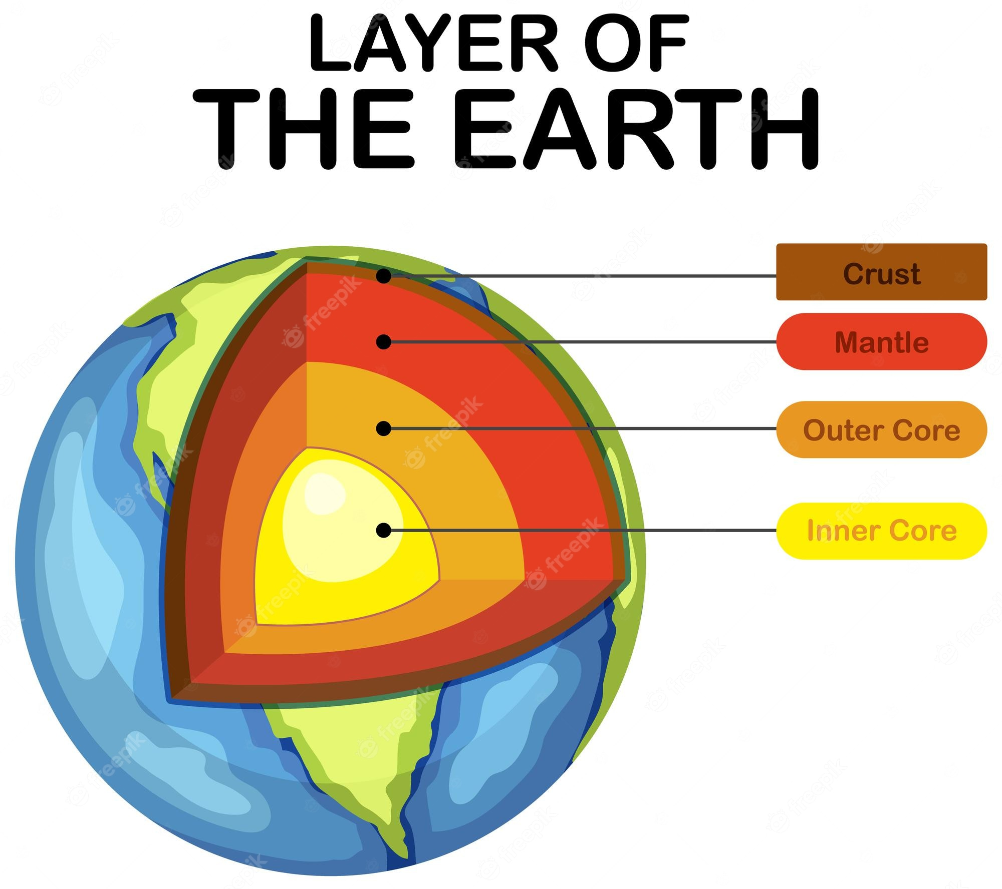
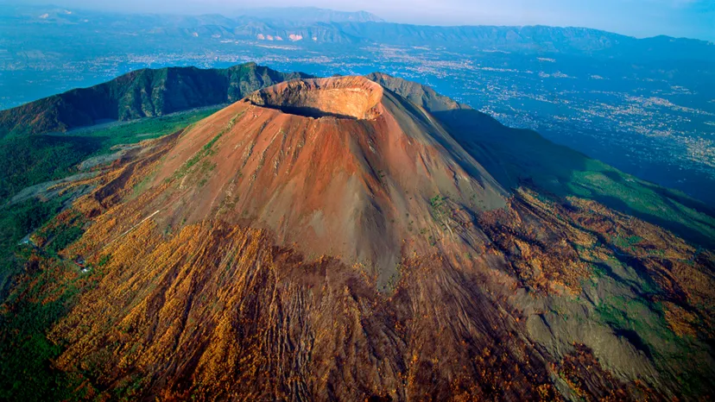
Year 3 – Spring Term Geography – Where would you find a volcano?
Vocabulary and Glossary |  | What is a volcano? A volcano is an opening of the Earth’s crust which can let magma, gases and ash escape from below the surface.
tectonic plate | A large, slow-moving piece of rock that makes up the Earth’s crust.
Ring of Fire | Area around the Pacific Ocean where many earthquakes and volcanic eruptions occur.
volcano | An opening of the Earth’s crust which can let magma and ash escape.
vent | An opening in the Earth’s crust through which lava escapes.
magma | Hot molten rock found in the Earth’s mantle. | Why do volcanoes erupt and what are the consequences? Magma is formed when the earth’s mantle melts Magma is lighter than rock so rises towards the Earth’s surface As the magma rises, bubbles of gas form inside it Pressure builds as the magma rises and the volcano erupts This can be very dangerous and destructive as the surrounding land can be covered by ash and lava (when magma escapes to the surface it is called lava).
lava | Hot, molten rock that comes out of a volcano.
molten | Metal or rock found in the Earth’s mantle.
volcanic eruption | The sudden and violent explosion of lava, gas, ash and rock out of a volcano.
Mount Vesuvius in Italy

Slide 2
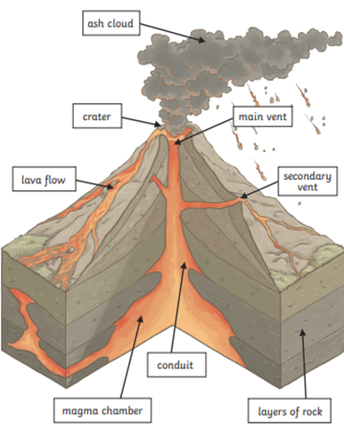
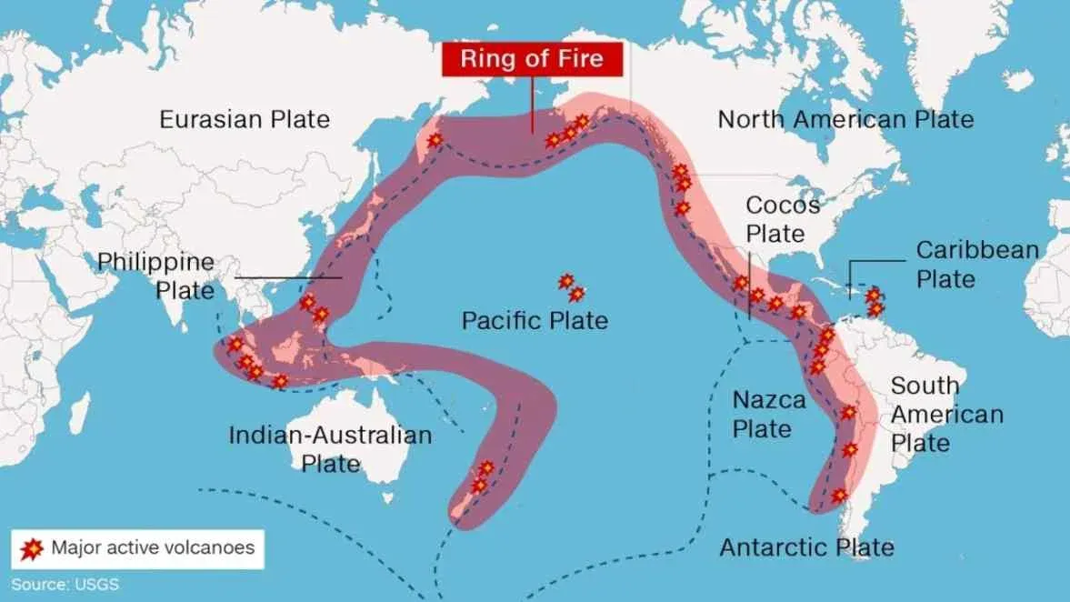
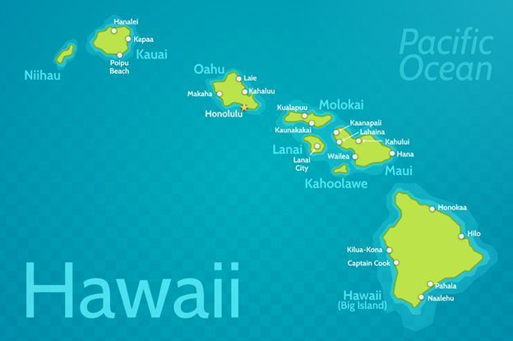
Where would you find a volcano?
What are the features of a volcano? | What are tectonic plates?
What are the benefits of living in a volcanic region? | How is Hawaii different to the UK? The Hawaiian Islands are volcanic islands. They have formed as the Earth’s crust, made up of giant rocky slabs called tectonic plates, moves over a particularly hot spot in the molten layer beneath the crust. The heat melts the rock that makes up the crust, turning it into magma. Then once the magma breaks through to the surface of the Earth’s crust it cools and forms new land.
Active – erupted recently with the possibility that it might erupt again
Dormant – has not erupted for a long time but could again in the future
Extinct – erupted thousands of years ago but will not erupt again
Composite – the most common type of volcano. They have violent eruptions and grow bigger due to layers of lava.
Shield - non violent eruptions. They tend to have gentle slopes so the lava spreads and hardens over a wide area.
Cinder cone - they are made up of small fragments of lava, which are blown into the air through a single vent. When they cool down, they form rock around the vent. They grow quickly, but aren’t usually very big or dangerous.
Advantages | How do people protect themselves?
Money from tourism | Listen to public warnings
Fertile soil – helps crops and plants to grow | Prepare emergency kits
Mining – rocks help form valuable minerals like gold | Some buildings are designed to minimize damage
A source of sustainable energy | Evacuation
Climate – tropical with trade winds
Average summer temperature: 29-31°C
Average winter temperature: 26-28°C
Physical features – islands, beaches, mountains, coral reef, seamounts, lava deserts, black sand beaches

